Slide 1
AF1001 Fundamentals of Accounting (BSE-3rd Semester)
Mr. Sami Ullah
Lecturer
NUCES Peshawar
GCR Code: iupp66m

Slide 2
Step-4
There is more to the measurement of business income than merely recording simple revenue and expense transactions that affect only a single accounting period. Certain transactions affect the revenue or expenses of two or more accounting periods. The purpose of adjusting entries is to assign to each accounting period appropriate amounts of revenue and expense.
For example, Overnight Auto Service purchased shop supplies that will be used for several months. Thus, an adjusting entry is required to record the expense associated with the shop supplies that Overnight uses each month.

Slide 3
THE NEED FOR ADJUSTING ENTRIES
For purposes of measuring income and preparing financial statements, the life of a business is divided into a series of accounting periods. This practice enables decision makers to compare the financial statements of successive periods and to identify significant trends.
But measuring net income for a relatively short accounting period—such as a month or even a year—poses a problem because, as mentioned above, some business activities affect the revenue and expenses of multiple accounting periods.

Slide 4
Therefore, adjusting entries are needed at the end of each accounting period to make certain that appropriate amounts of revenue and expense are reported in the company’s income statement.
These entries assign revenues to the period in which they are earned, and expenses to the periods in which related goods or services are used.
In theory, a business could make adjusting entries on a daily basis. But as a practical matter, these entries are made only at the end of each accounting period. For most companies, adjusting entries are made on a monthly basis.

Slide 5
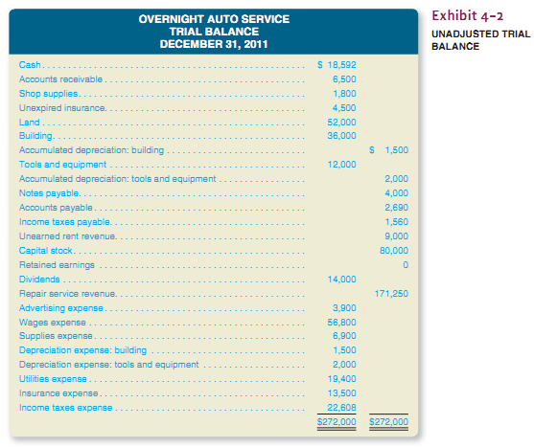
In the next few slides we illustrate several transactions, as well as the related adjusting entries. Both are shown in the format of general journal entries. To help distinguish between transactions and adjusting entries, transactions are printed in blue and adjusting entries in red.

Slide 6

The number of adjustments needed at the end of each accounting period depends entirely upon the nature of the company’s business activities. However, most adjusting entries fall into one of four general categories:
TYPE I: CONVERTING ASSETS TO EXPENSES
Type II: CONVERTING LIABILITIES TO REVENUE
TYPE III: ACCRUING UNPAID EXPENSES
TYPE IV: ACCRUING UNCOLLECTED REVENUE

Slide 7
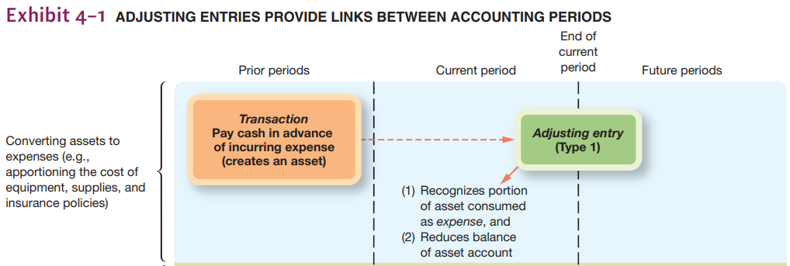
TYPE I: CONVERTING ASSETS TO EXPENSES
A cash expenditure (or cost) that will benefit more than one accounting period usually is recorded by debiting an asset account (for example, Supplies, Unexpired Insurance, and so on) and by crediting Cash.

Slide 8
An adjusting entry to convert an asset to an expense consists of a debit to an expense account and a credit to an asset account (or contra-asset account). Examples of these adjustments include the entries to apportion the costs of prepaid expenses and entries to record depreciation expense.
Prepaid Expenses Payments in advance often are made for such items as insurance, rent, and office supplies. If the advance payment (or prepayment) will benefit more than just the current accounting period, the cost represents an asset rather than an expense. The cost of this asset will be allocated to expense in the accounting periods in which the services or the supplies are used. In summary, prepaid expenses are assets; they become expenses only as the goods or services are used up.

Slide 9
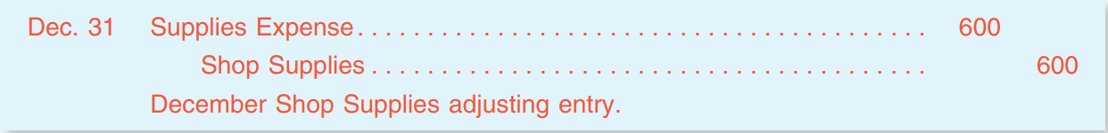
Example: It is not practical to make journal entries every few minutes as supplies are used. Instead, an estimate is made of the supplies remaining on hand at the end of each month; the supplies that are “missing” are assumed to have been used. Prior to making adjusting entries at December 31, the balance in Overnight’s Shop Supplies account is $1,800. The balance of this asset account represents shop supplies on hand on November 30. The Supplies Expense account shows a balance of $6,900, which represents the cost of supplies used through November 30. Assume that approximately $1,200 of shop supplies remain on hand at December 31. This suggests that supplies costing about $600 have been used in December; thus, the following adjusting entry is made:

Slide 10
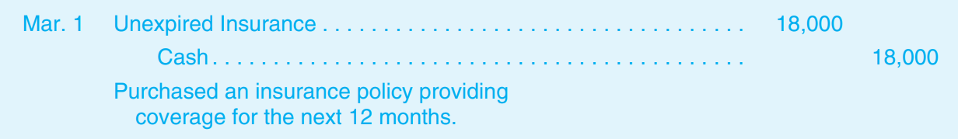
Insurance Policies: Insurance policies also are a prepaid expense. These policies provide a service, insurance protection, over a specific period of time. As the time passes, the insurance policy expires —that is, it is used up in business operations.
To illustrate, assume that on March 1, Overnight purchased for $18,000 a one-year insurance policy providing comprehensive liability insurance and insurance against fire and damage to customers’ vehicles while in Overnight’s facilities. This expenditure (a transaction ) was debited to an asset account, as follows (again, this is a transaction, not an adjusting entry):

Slide 11
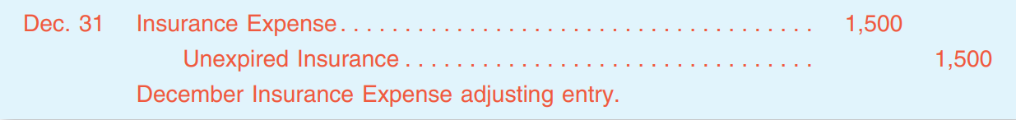
This $18,000 expenditure provides insurance coverage for a period of one full year. Therefore, 1/12 of this cost, or $1,500, is recognized as insurance expense every month. The $13,500 insurance expense reported in Overnight’s trial balance represents the portion of the insurance policy that has expired between March 1 and November 30 ($1,500/mo. *9 months). The $4,500 amount of unexpired insurance shown in the trial balance is the remaining cost of the 12-month policy still in effect as of November 30 ($1,500/mo.*3 months). By December 31, another full month of the policy has expired. Thus, the insurance expense for December is recorded by the following adjusting entry at month-end:

Slide 12
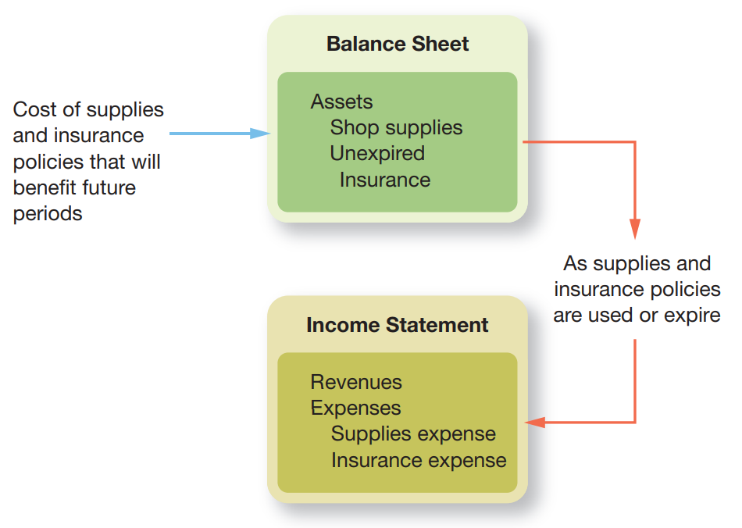

Notice the similarities between the effects of this adjusting entry and the one that we made previously for shop supplies. In both cases, the entries transfer to expense that portion of an asset used up during the period. This flow of costs from the balance sheet to the income statement is illustrated in Exhibit 4–3

Slide 13
THE CONCEPT OF DEPRECIATION
Depreciable assets are physical objects that retain their size and shape but that eventually wear out or become obsolete. They are not physically consumed, as are assets such as supplies, but nonetheless their economic usefulness diminishes over time. Examples of depreciable assets include buildings and all types of equipment, fixtures, furnishings—and even railroad tracks. Land, however, is not viewed as a depreciable asset, as it has an unlimited useful life.
Each period, a portion of a depreciable asset’s usefulness expires. Therefore, a corresponding portion of its cost is recognized as depreciation expense.

Slide 14
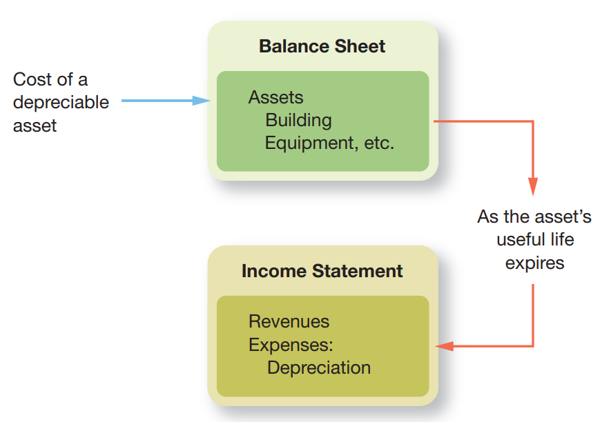
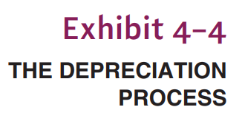
What Is Depreciation? In accounting, the term depreciation means the systematic allocation of the cost of a depreciable asset to expense over the asset’s useful life. This process is illustrated in Exhibit 4–4
Depreciation expense occurs continuously over the life of the asset, but there are no daily “depreciation transactions.” In effect, depreciation expense is paid in advance when the asset is originally purchased. Therefore, adjusting entries are needed at the end of each accounting period to transfer an appropriate amount of the asset’s cost to depreciation expense.

Slide 15
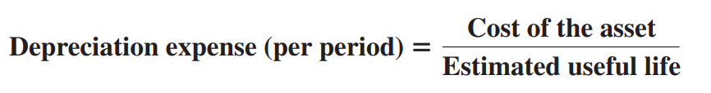
Depreciation Is Only an Estimate: The appropriate amount of depreciation expense is only an estimate. After all, we cannot look at a building or a piece of equipment and determine precisely how much of its economic usefulness has expired during the current period.
The most widely used means of estimating periodic depreciation expense is the straight line method of depreciation. Under the straight-line approach, an equal portion of the asset’s cost is allocated to depreciation expense in every period of the asset’s estimated useful life. The formula for computing depreciation expense by the straight-line method is:

Slide 16
Depreciation of Overnight’s Building Overnight purchased its building for $36,000 on January 22. Because the building was old, its estimated remaining useful life is only 20 years. Therefore, the building’s monthly depreciation expense is $150 ($36,000 cost /240 months). We will assume that Overnight did not record any depreciation expense in January because it operated for only a small part of the month. Thus, the building’s $1,500 depreciation expense reported in Overnight’s trial balance illustrated in Exhibit 4–2 on page 143 represents 10 full months of depreciation recorded in 2011, from February 1 through November 30 ($150/mo. * 10 months).

Slide 17
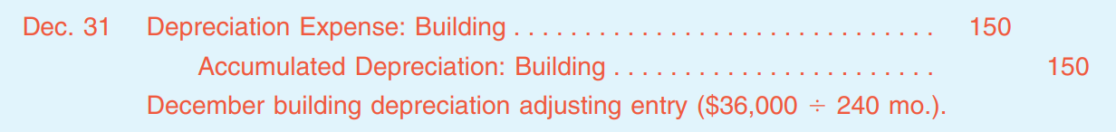
An additional $150 of depreciation expense is still needed on the building for December (bringing the total to be reported in the income statement for the year to $1,650).
The adjusting entry to record depreciation expense on Overnight’s building for the month of December is

Slide 18
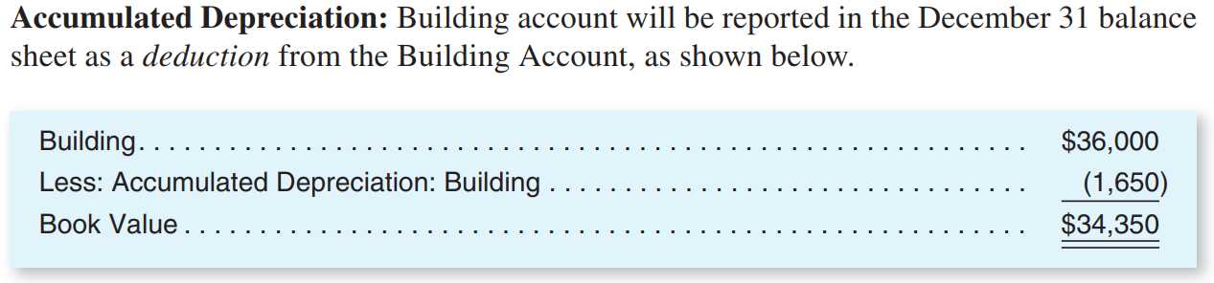
Accumulated Depreciation-Building is an example of a contra-asset account because (1) it has a credit balance, and (2) it is offset against an asset account (Building) to produce the book value for the asset. Accountants often use the term book value (or carrying value ) to describe the net valuation of an asset in a company’s accounting records. For depreciable assets, such as buildings and equipment, book value is equal to the cost of the asset, less the related amount of accumulated depreciation. The end result of crediting the Accumulated Depreciation-Building account is much the same as if the credit had been made directly to the Building account; that is, the book value reported in the balance sheet for the building is reduced from $36,000 to $34,350.

Slide 19
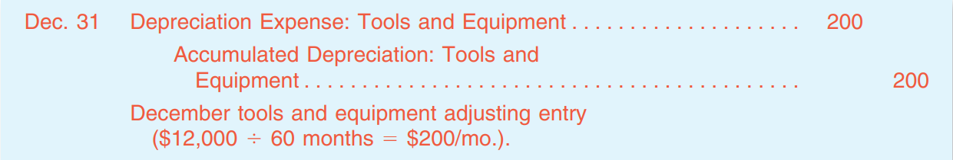
Depreciation of Tools and Equipment
Overnight depreciates its tools and equipment over a period of five years (60 months) using the straight-line method. The December 31 trial balance shows that the company owns tools and equipment that cost $12,000. Therefore, the adjusting entry to record December’s depreciation expense is:

Slide 20
TYPE II: CONVERTING LIABILITIES TO REVENUE
In some instances, customers may pay in advance for services to be rendered in later accounting periods. For example, a football team collects much of its revenue in advance through the sale of season tickets. Health clubs collect in advance by selling long-term membership contracts. Airlines sell many of their tickets well in advance of scheduled flights.
For accounting purposes, amounts collected in advance do not represent revenue, because these amounts have not yet been earned. Amounts collected from customers in advance are recorded by debiting the Cash account and crediting an unearned revenue account. Unearned revenue also may be called deferred revenue.

Slide 21


To illustrate these concepts, assume that on December 1, Harbor Cab Co. agreed to rent space in Overnight’s building to provide indoor storage for some of its cabs. The agreed-upon rent is $3,000 per month, and Harbor Cab paid for the first three months in advance.
The journal entry to record this transaction on December 1 was (again, this is a transaction, not an adjusting entry):

Slide 22
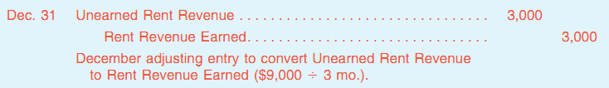
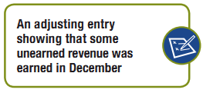
Remember that Unearned Rent Revenue is a liability account, not a revenue account. Overnight will earn rental revenue gradually over a three-month period as it provides storage facilities for Harbor Cab. At the end of each of these three months, Overnight will make an adjusting entry, transferring $3,000 from the Unearned Rent Revenue account to an earned revenue account, Rent Revenue Earned, which will appear in Overnight’s income statement.
The first in this series of monthly transfers will be made at December 31 with the following adjusting entry:

Slide 23
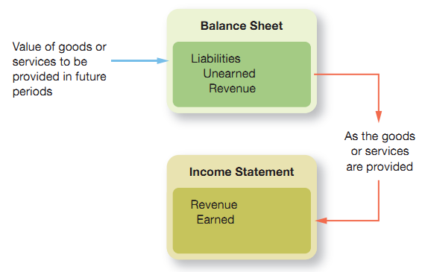
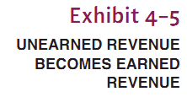
The conversion of unearned revenue to recognize earned revenue is illustrated in Exhibit 4–5.

Slide 24
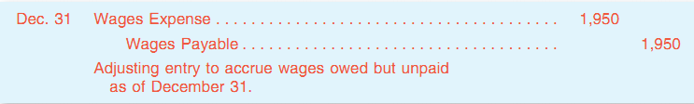
TYPE III: ACCRUING UNPAID EXPENSES
Expenses accrued over a time period but not yet paid is an unpaid expense.
Overnight, like many businesses, pays its employees every other Friday. This month, however, ends on a Tuesday—three days before the next scheduled payday. Thus Overnight’s employees have worked for more than a week in December for which they have not yet been paid.
Time cards indicate that since the last payroll date, Overnight’s employees have worked a total of 130 hours. Including payroll taxes, Overnight’s wage expense averages about $15 per hour. Therefore, at December 31, the company owes its employees approximately $1,950 for work performed in December. The following adjusting entry should be made to record this amount both as wages expense of the current period and as a liability:

Slide 25
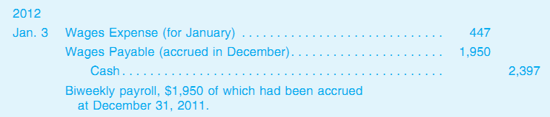
On Friday, January 3, 2012, Overnight will pay its regular biweekly payroll. Let us assume that this payroll amounts to $2,397. In this case, the transaction to record payment is as follows (again, this is a transaction, not an adjusting entry):

Slide 26

Accrual of Interest Expense
On November 30, 2011, Overnight borrowed $4,000 from American National Bank by issuing an interest-bearing note payable. This loan is to be repaid in three months (on February 28, 2012), along with interest computed at an annual rate of 9 percent. The entry made on November 30 to record this borrowing transaction is (again, this is a transaction, not an adjusting entry):

Slide 27
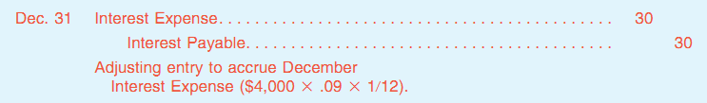
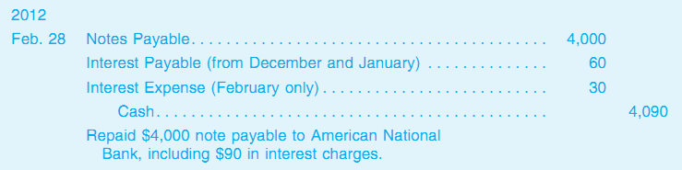
The following adjusting entry is made at December 31 to accrue one month’s interest expense and to record the amount of interest owed to the bank at December 31, 2011:
Adjusting entry required to record interest expense accrued in December
Overnight will make a second adjusting entry recognizing another $30 in interest expense
on January 31, 2012. The transaction on February 28 to record the repayment of this loan,
including $90 in interest charges, is (again, this is a transaction, not an adjusting entry):
Payment of interest expense
accrued over three months

Slide 28
TYPE IV: ACCRUING UNCOLLECTED REVENUE
Any revenue that has been earned but not recorded during the current accounting period should be recorded at the end of the period by means of an adjusting entry.
This adjusting entry consists of a debit to an account receivable and a credit to the appropriate revenue account.
The term accrued revenue often is used to describe revenue that has been earned during the period but that has not been recorded prior to the closing date.
To illustrate this type of adjusting entry, assume that in December, Overnight entered into an agreement to perform routine maintenance on several vans owned by Airport Shuttle Service. Overnight agreed to maintain these vans for a flat fee of $1,500 per month, payable on the fifteenth of each month.

Slide 29
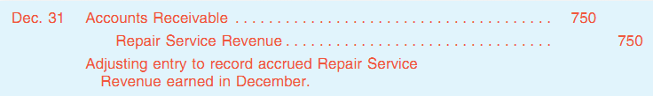
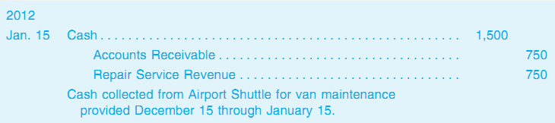
Overnight began rendering services on December 15, but the first monthly payment will not be received until January 15. Therefore, Overnight should make the following adjusting entry at December 31 to record the revenue earned from Airport Shuttle during the month:
The collection of the first monthly fee from Airport Shuttle will occur on January 15, 2012. Of this $1,500 cash receipt, half represents collection of the receivable recorded on December 31; the other half represents revenue earned in January. Thus, the transaction to record the receipt of $1,500 from Airport Shuttle on January 15 will be (again, this is a transaction, not an adjusting entry):

Slide 30
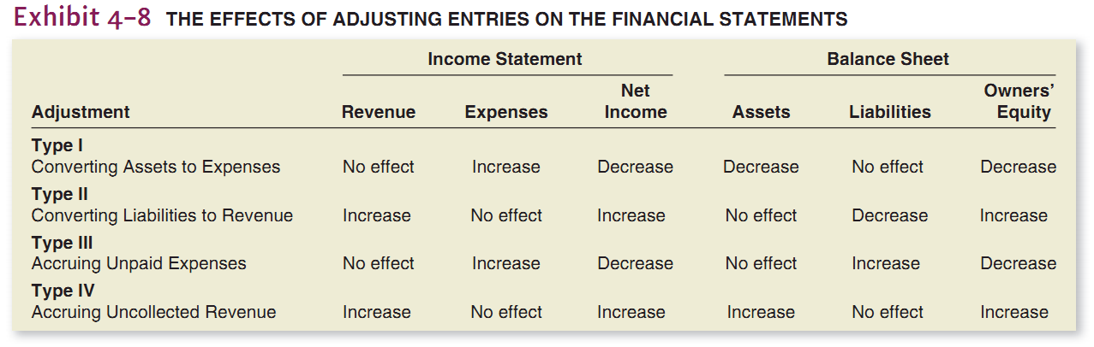
EFFECTS OF THE ADJUSTING ENTRIES
On pages 140 and 141 (book pages) we identified four types of adjusting entries, each of which involve one income statement account and one balance sheet account. The effects of these adjustment types on the income statement and balance sheet are summarized in Exhibit 4–8 .

Slide 31
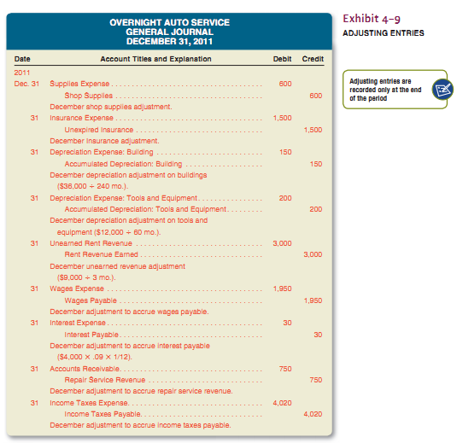

Slide 32
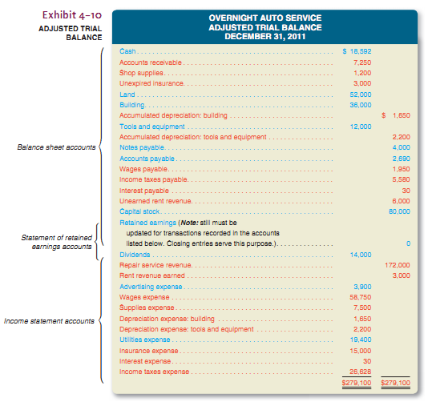
Step-5 of accounting Cycle
Adjusted Trial Balance is a trial balance
Prepared after period end adjustments
(adjusting entries) are made. From Adjusted trial balance, Income statement, Owners equity Statement (in case of sole proprietorship & partnership) And Retained earning statement (in case of corporation/compay) And balance sheet are prepared.

